Slide 1
Sharing alumni bidang murni
Grotius Cendikia Hasiholan 20 Mei 2023

Slide 2
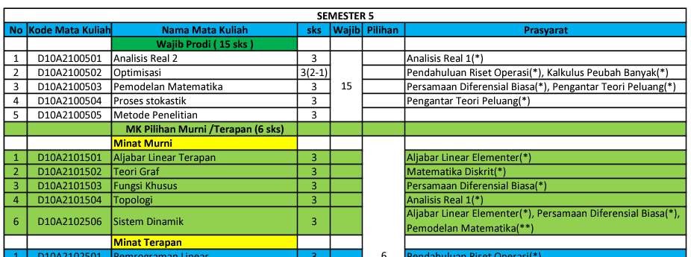
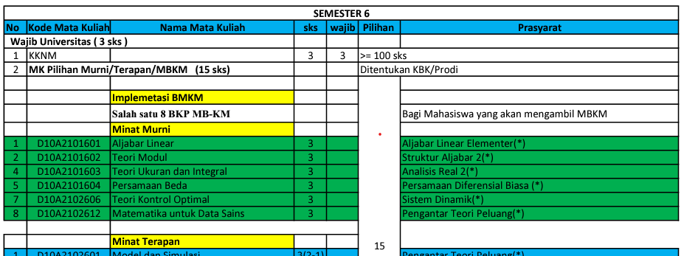
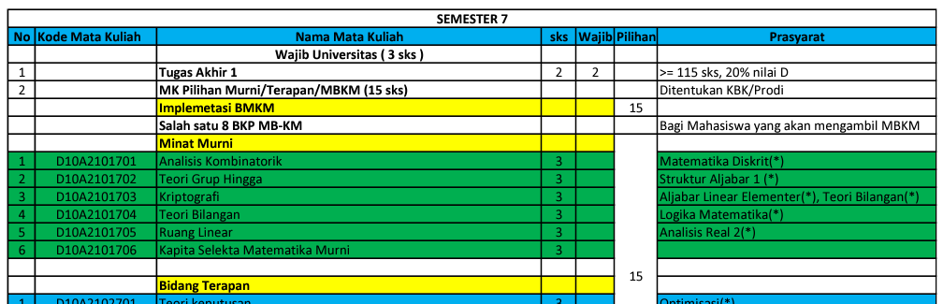
Courses
Source: https://matematika.unpad.ac.id/s1/kurikulum/

Slide 3
ROADMAP
*) Kurikulum 2016

Slide 4

Pure mathematics and applied mathematics
Pure Mathematics
Applied Mathematics
Pure mathematics is math for math’s sake.
Explores abstract concepts, complex theories and never-before-solved problems
Pure mathematicians test each other’s hypotheses and dive headfirst into uncharted mathematical waters.
APPLIED MATHEMATICS
More “practical” form of math
Applied mathematicians are tasked with a real-world problem to solve.
PURE MATHEMATICS

Slide 5
REAL PURE MATHEMATICS?
Source: https://matematika.unpad.ac.id/s1/kurikulum/

Slide 6
Course Classification
Applied Mathematics
(can be assumed)
Pure Mathematics
Aljabar Linear Terapan
Sistem Dinamik
Teori Graph
Fungsi Khusus
Analisis Kombinatorik
Persamaan Beda
Teori Kontrol Optimal
Analisis Kombinatorik
Kriptografi
Teori Bilangan
Topologi
Aljabar Linear
Teori Modul
Teori Ukuran Integral
Teori Grup Hingga
Ruang Linear
Kapita Selekta Murni

Slide 7
Image compression
Singular value decomposition – aljabar linear terapan

Slide 8
Kriptografi (hill-cipher) aljabar linear terapan / kriptografi

Slide 9
NASH EQUILIBRIUM (GAME THEORY) teori Bilangan

Slide 10
PURE MATHEMATICS?

Slide 11
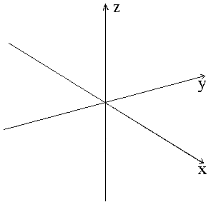
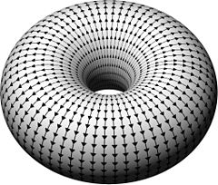


FIELD THEORY
Struktur aljabar 2
Definition Field:
A field is a commutative ring with unity in which every nonzero element is a unit.
(Gallian, 2010)
y
$$ℝ_{3}$$
$$ℝ_{2}$$
x

Slide 12
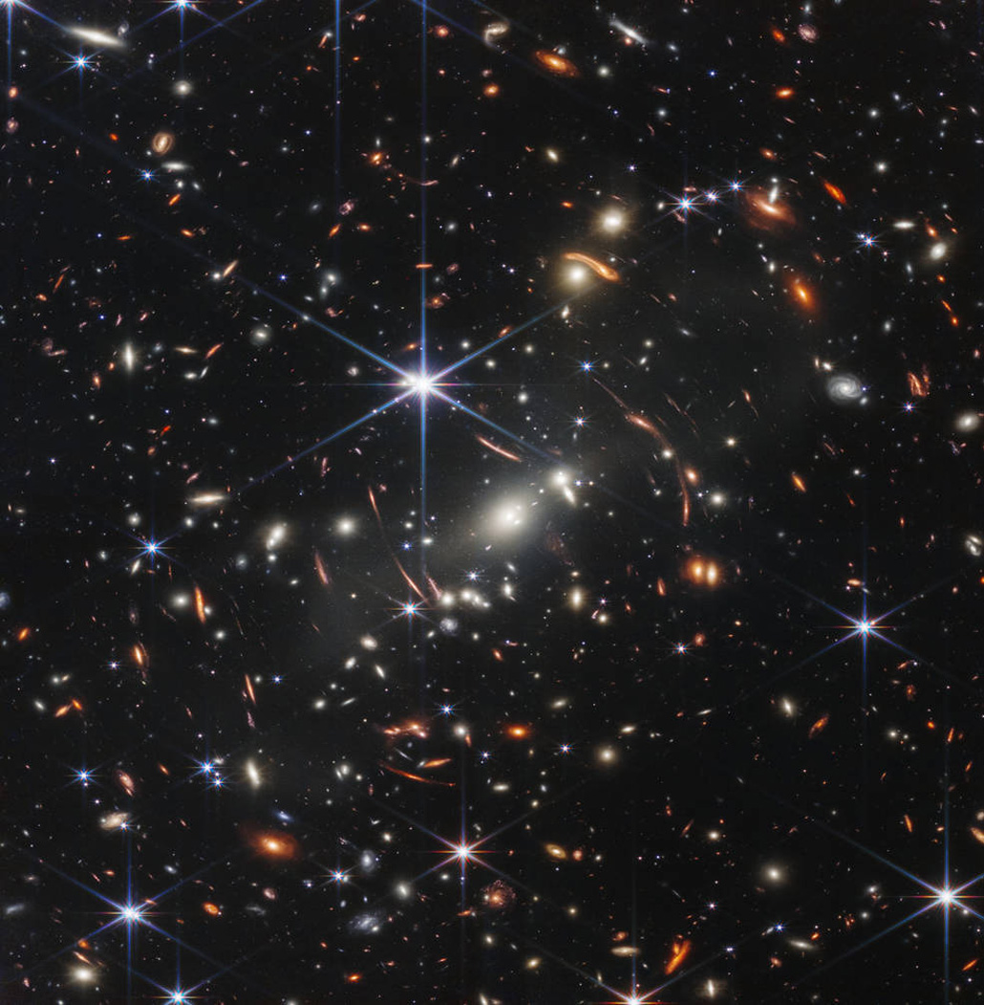
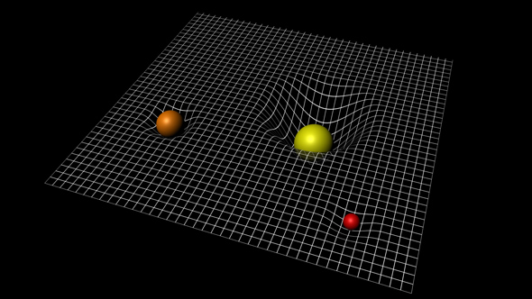
FIELD THEORY
Struktur aljabar 2

Slide 13
Kegunaan dalam dunia pasca kampus
Critical thinking
Fundamental-Prioritized
Structured Mind
Rich Idea
Sebagai Software Engineer:
Lebih peduli terhadap angka
Pengoptimalan kalkulasi
Mudah mempelajari proses bisnis
.
.
.
99. Lebih terbiasa dalam mengahadapi kesulitan :D

Slide 14
Kegunaan dalam dunia pasca kampus
Critical thinking
Fundamental-Prioritized
Structured Mind
Rich Idea
Sebagai Software Engineer:
Lebih peduli terhadap angka
Pengoptimalan kalkulasi
Mudah mempelajari proses bisnis
.
.
.
99. Lebih terbiasa dalam mengahadapi kesulitan :D

Slide 15

JANGAN BATASI
DIRI SENDIRI!

Slide 16
THANK YOU

